Slide 1

Using ChatGPT to create a Shiny App for Estimation of Peptide Concentration in a Sample.
PRESENTER: EMMANUEL TOBECHUKWU UGWUOJI
April 25, 2024

Slide 2
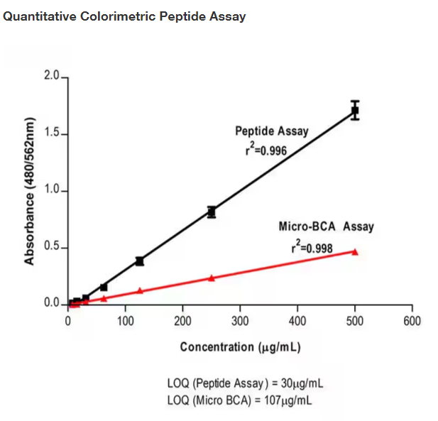
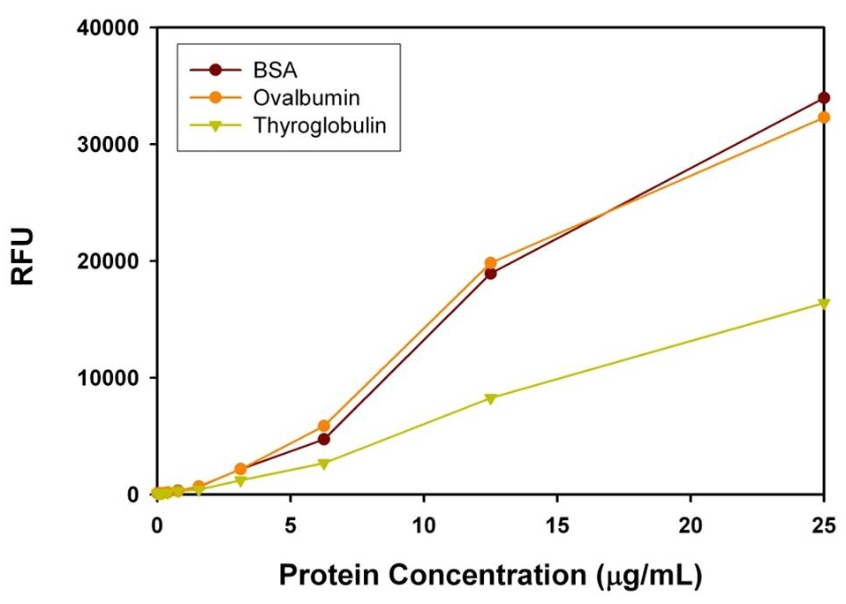
Peptide Quantitation
Methods
Fluorimetric Peptide Assay

Slide 3
SPECIFIC OBJECTIVES
To attempt to build a Shiny App that generates a scatter plot that shows the relationship between the two variables.
To include in the plot a line of regression.
To ensure that the generated code displays the r-squared value indicative of the strength of the relationship between the two variables.
To be able to estimate peptide concentration using fluorescent reads.
To document and understand which kind of prompt can lead ChatGPT to produce useful or not useful code

Slide 4
SPECIFIC OBJECTIVES
To attempt to build a Shiny App that generates a scatter plot that shows the relationship between the two variables.
To include in the plot a line of regression.
To ensure that the generated code displays the r-squared value indicative of the strength of the relationship.
To be able to estimate peptide concentration using fluorescent reads.
To document and understand which kind of prompt can lead ChatGPT to produce useful or not useful code

Slide 5
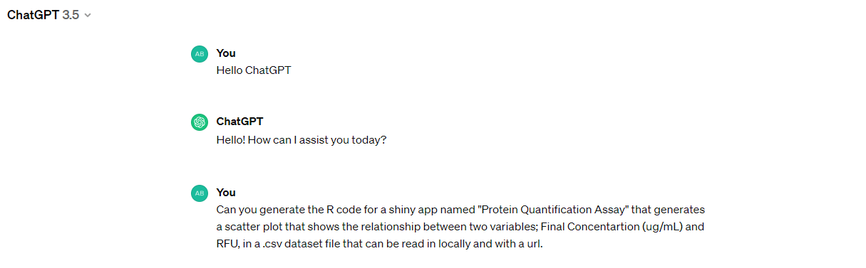
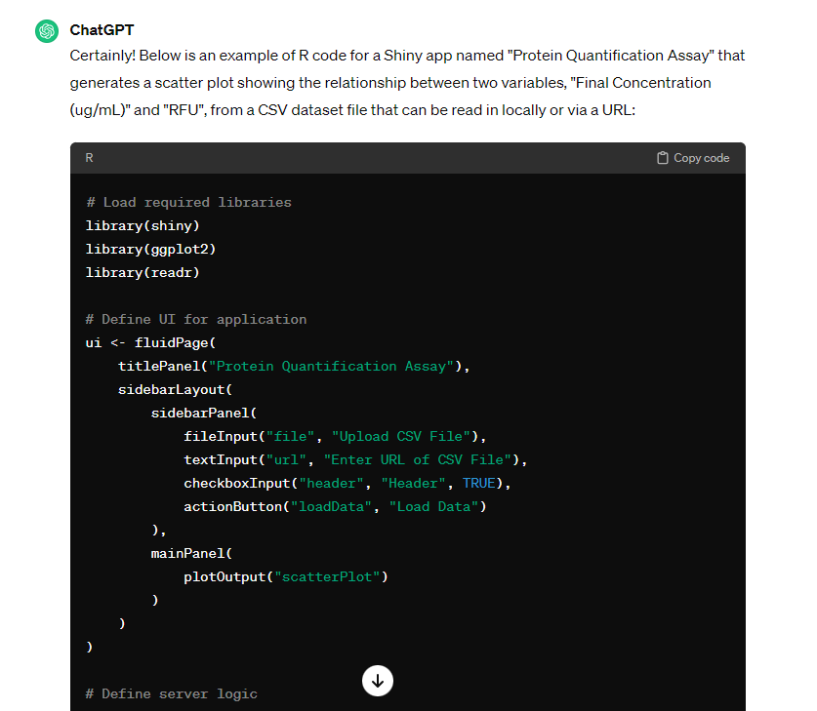
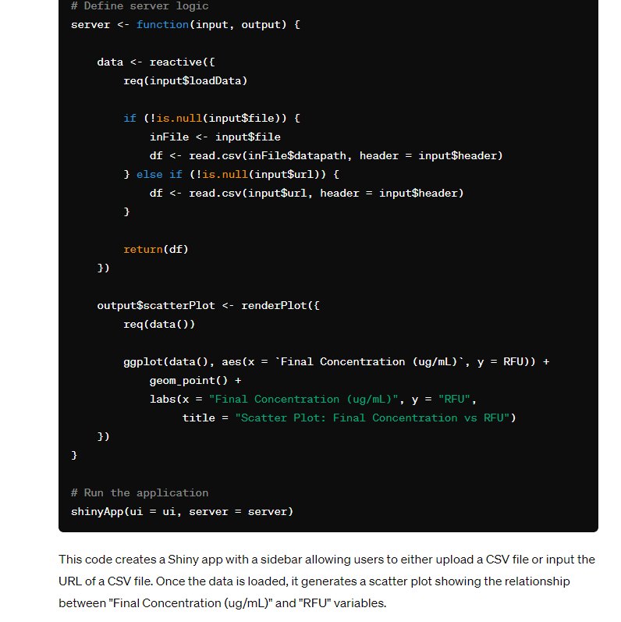

Slide 6
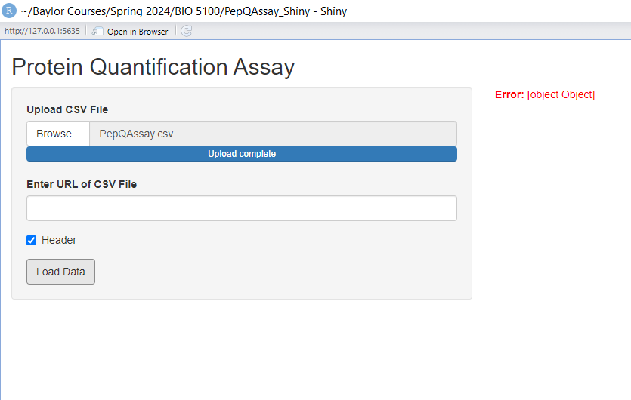
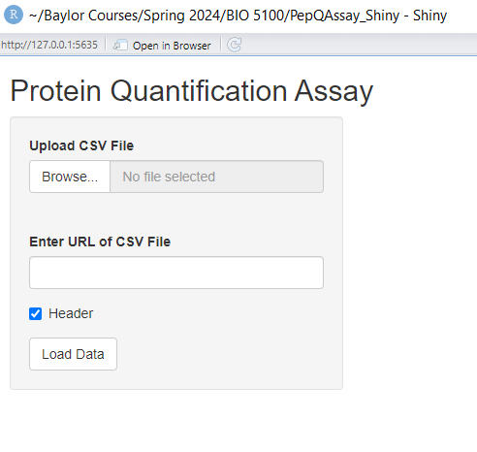
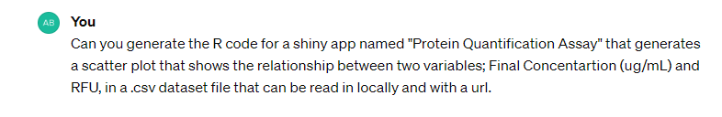

Slide 7
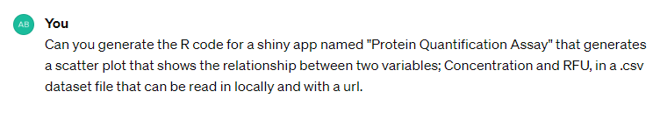
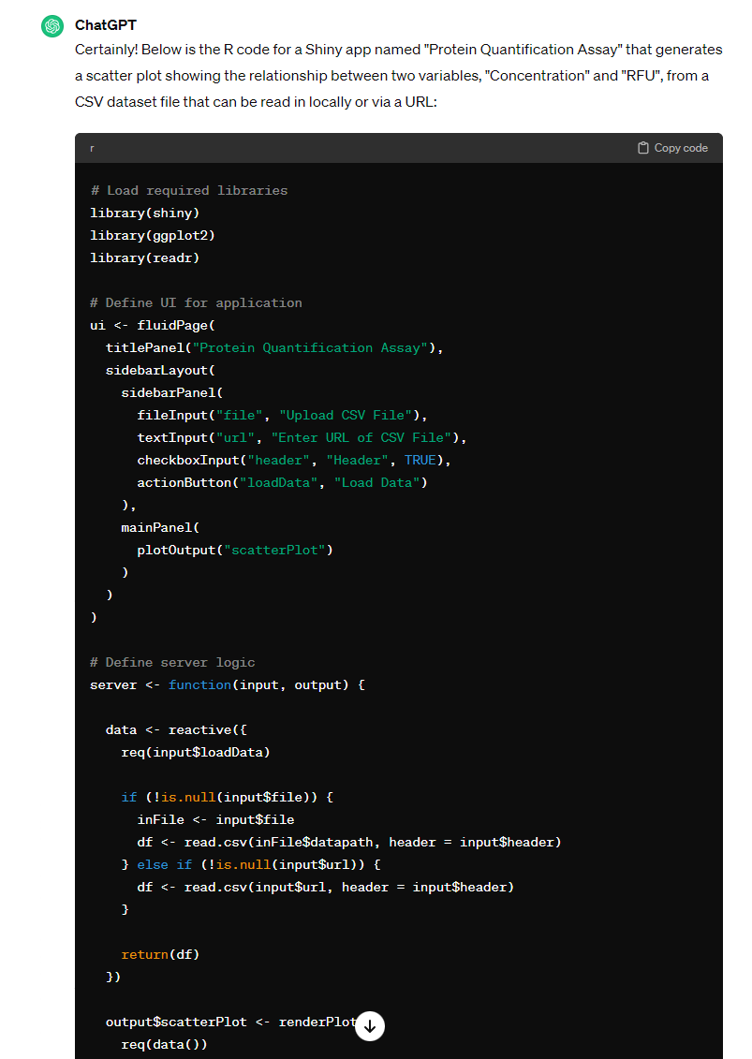
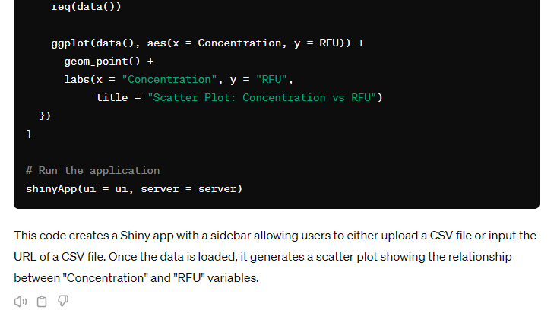

Slide 8
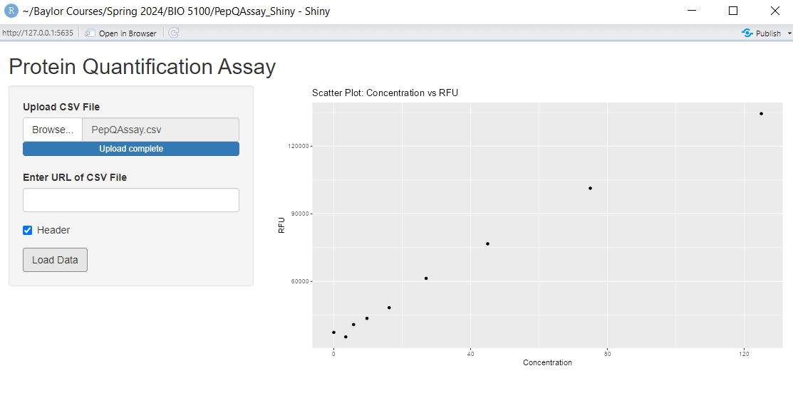
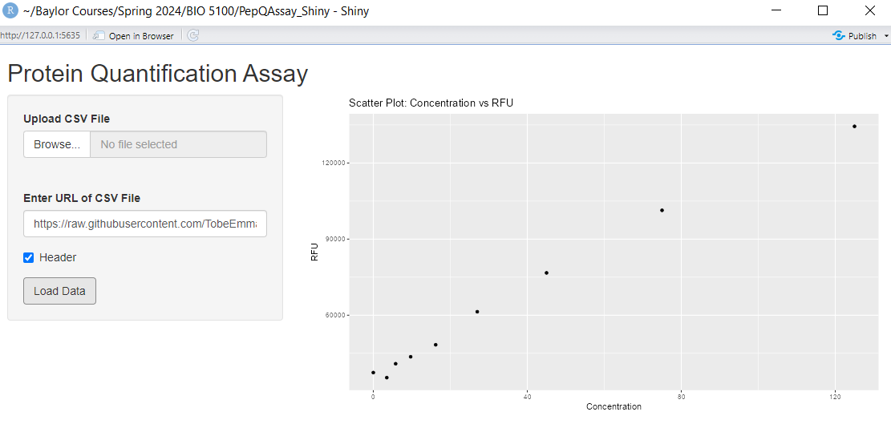

Slide 9
SPECIFIC OBJECTIVES
To attempt to build a Shiny App that generates a scatter plot that shows the relationship between the two variables.
To include in the plot a line of regression.
To ensure that the generated code displays the r-squared value indicative of the strength of the relationship.
To be able to estimate peptide concentration using fluorescent reads.
To document and understand which kind of prompt can lead ChatGPT to produce useful or not useful code

Slide 10

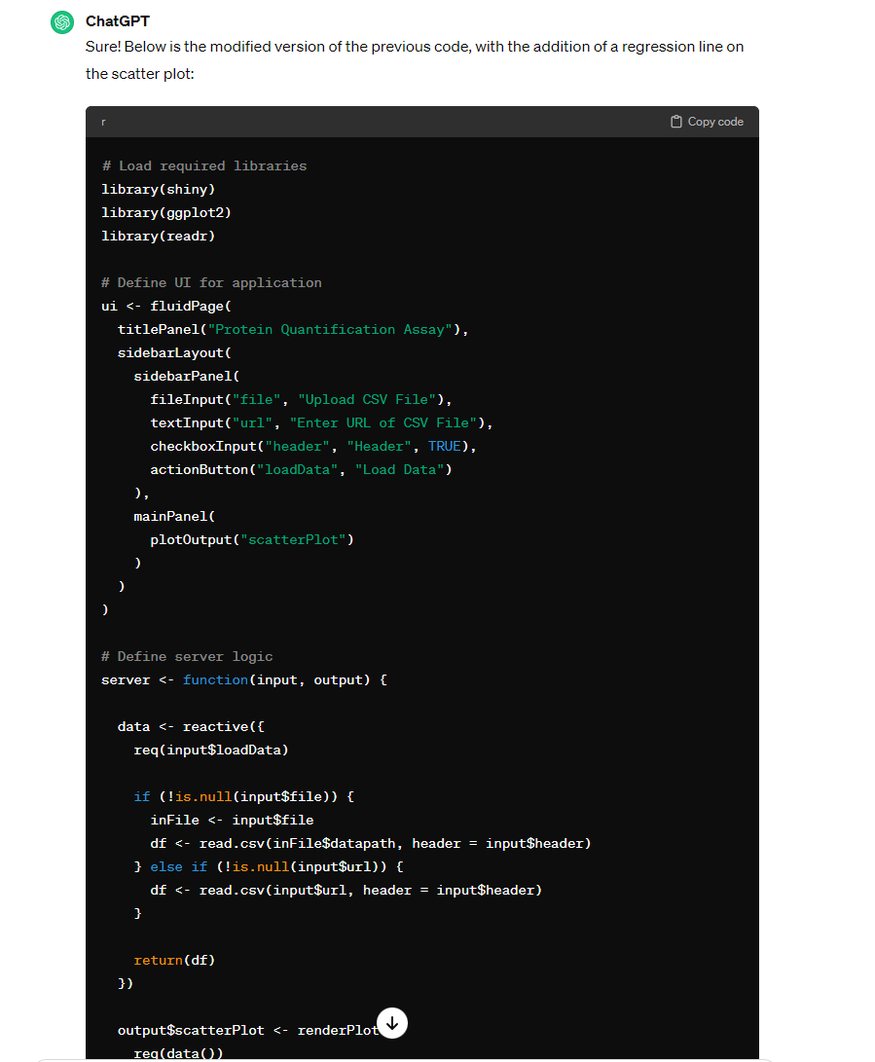
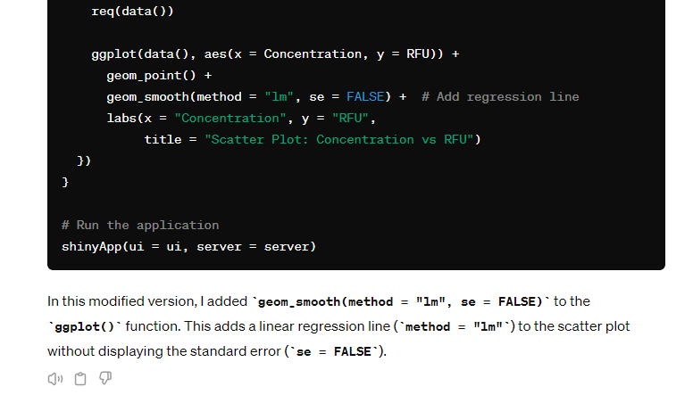

Slide 11
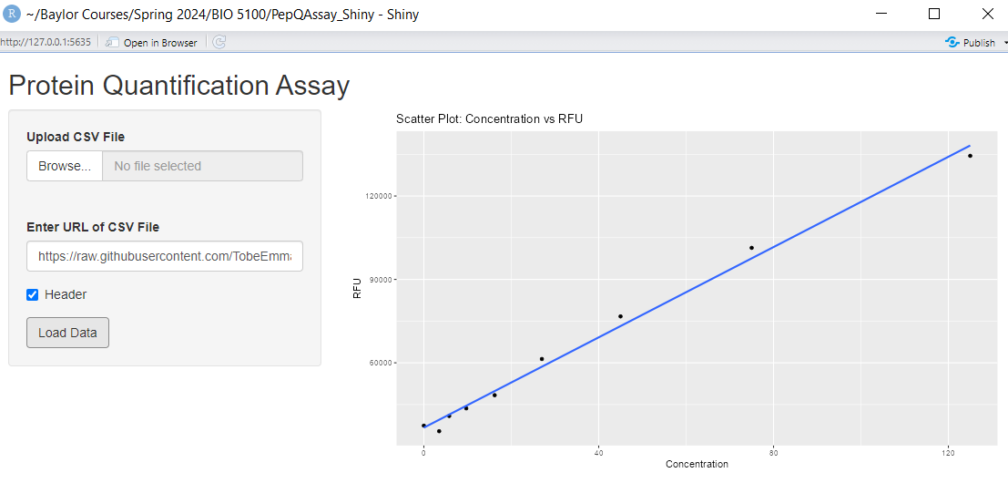
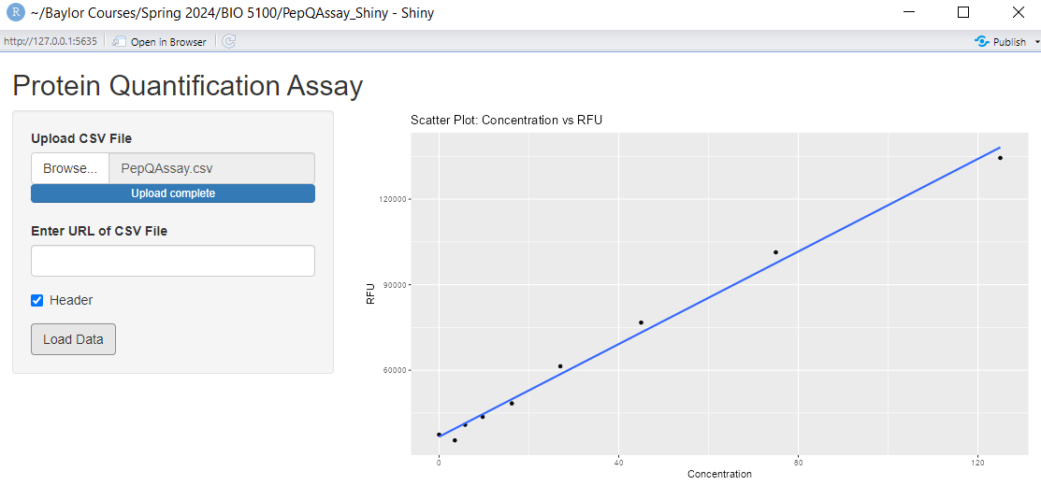

Slide 12
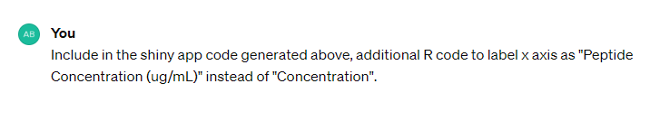
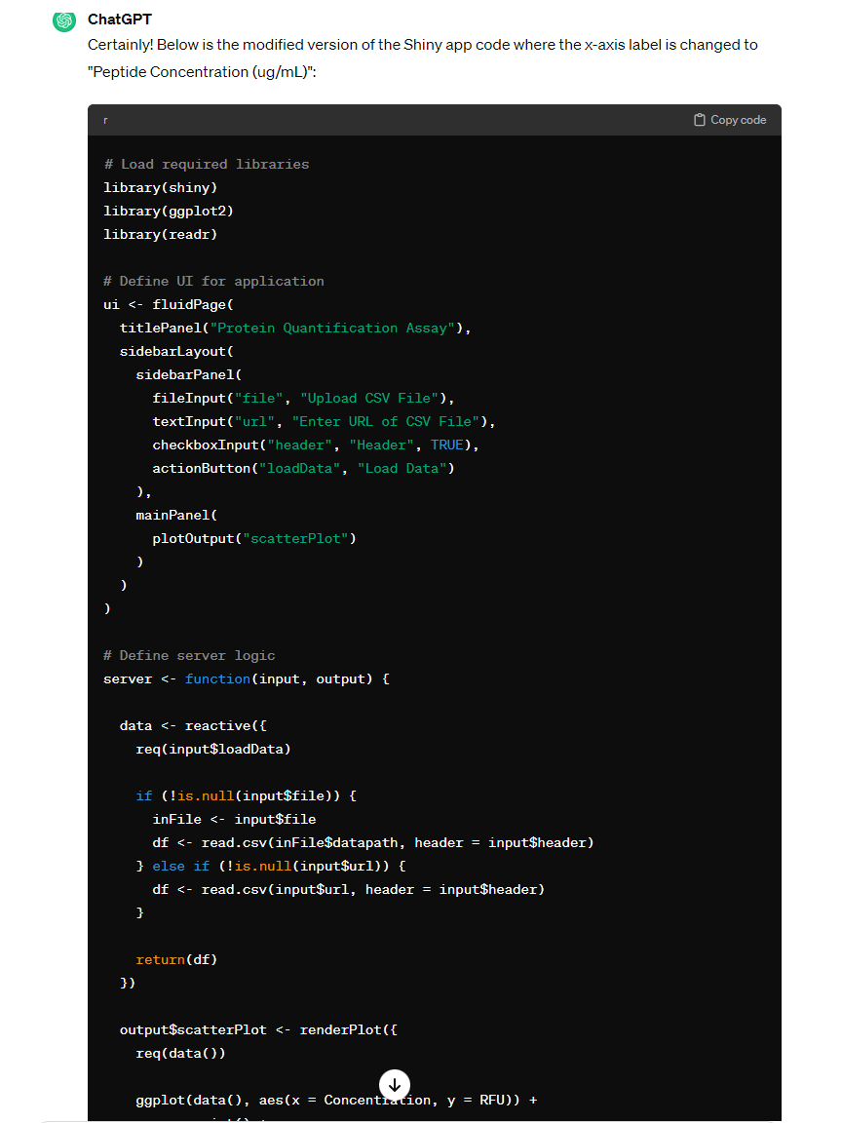
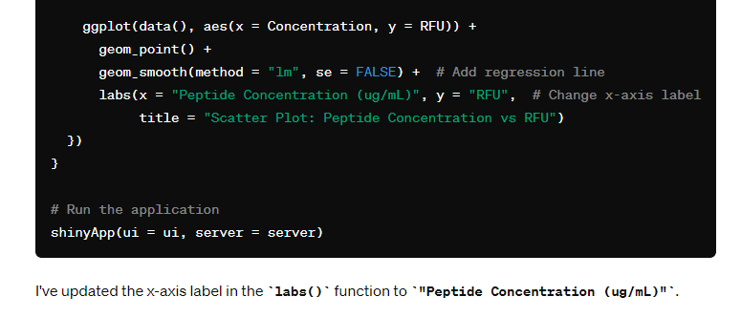

Slide 13
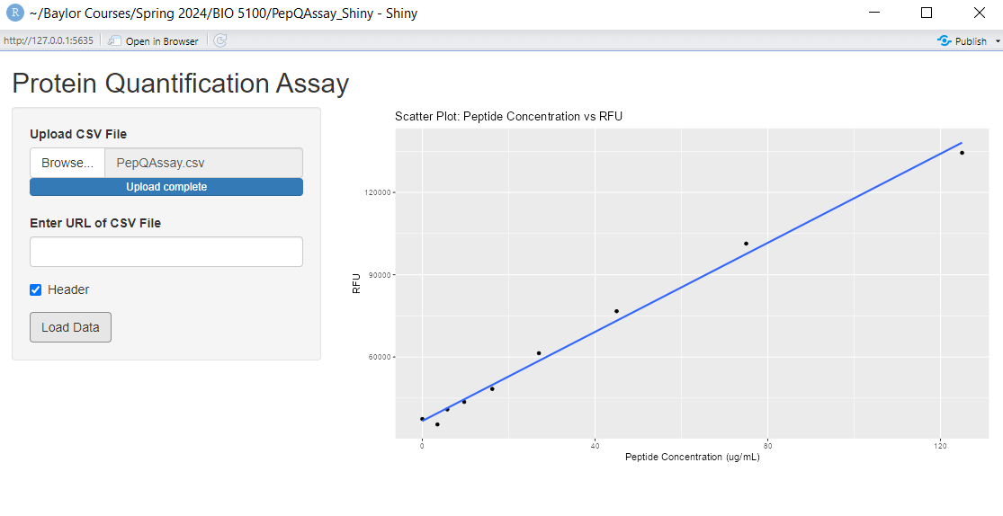

Slide 14
SPECIFIC OBJECTIVES
To attempt to build a Shiny App that generates a scatter plot that shows the relationship between the two variables.
To include in the plot a line of regression.
To ensure that the generated code displays the r-squared value indicative of the strength of the relationship.
To be able to estimate peptide concentration using fluorescent reads.
To document and understand which kind of prompt can lead ChatGPT to produce useful or not useful code

Slide 15
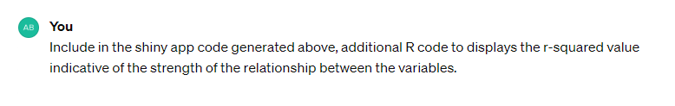
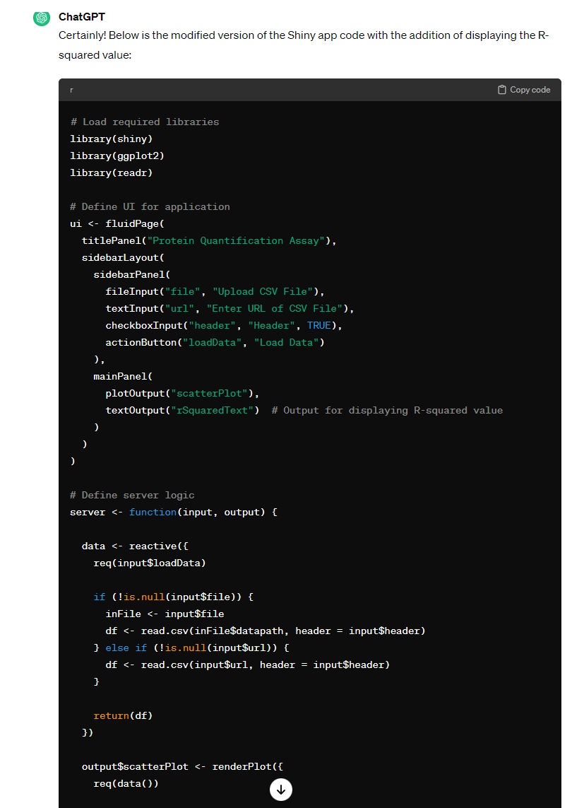
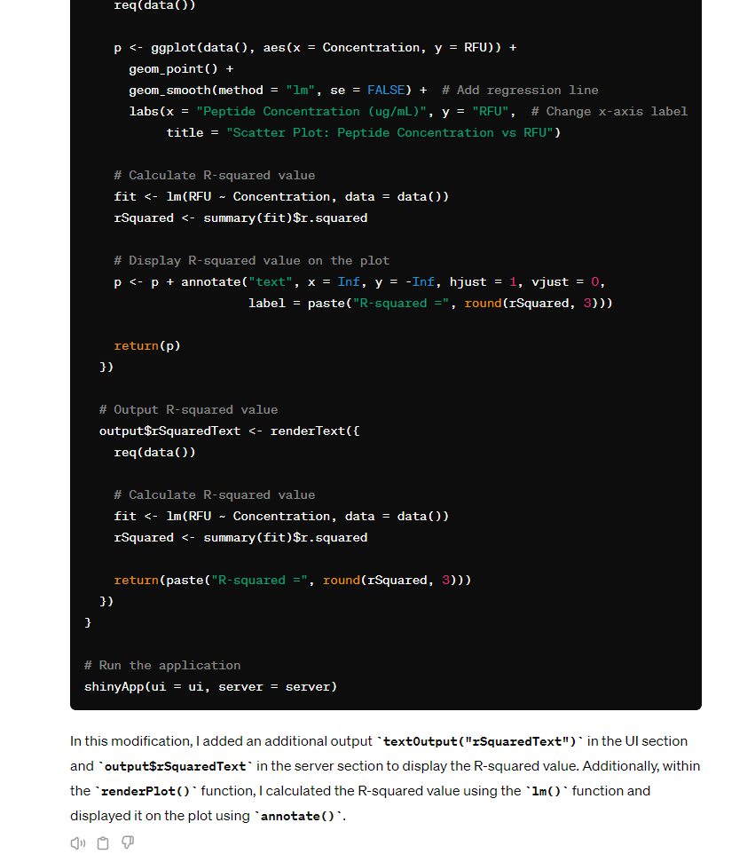

Slide 16
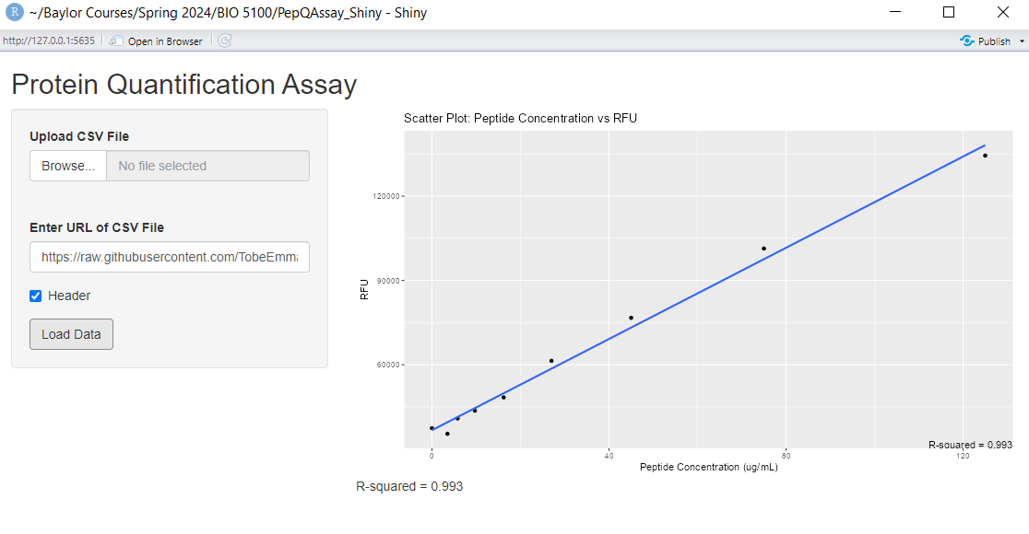

Slide 17
SPECIFIC OBJECTIVES
To attempt to build a Shiny App that generates a scatter plot that shows the relationship between the two variables.
To include in the plot a line of regression.
To ensure that the generated code displays the r-squared value indicative of the strength of the relationship.
To be able to estimate peptide concentration using fluorescent reads.
To document and understand which kind of prompt can lead ChatGPT to produce useful or not useful code

Slide 18
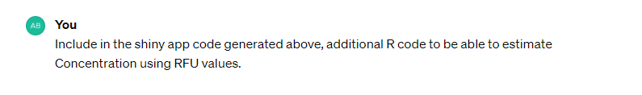
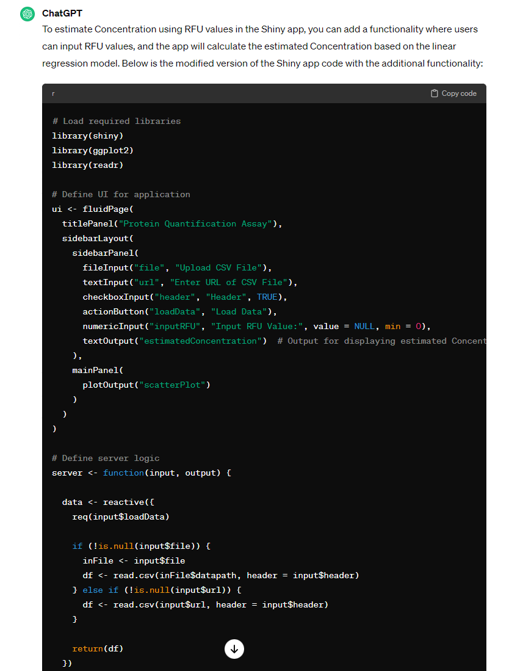
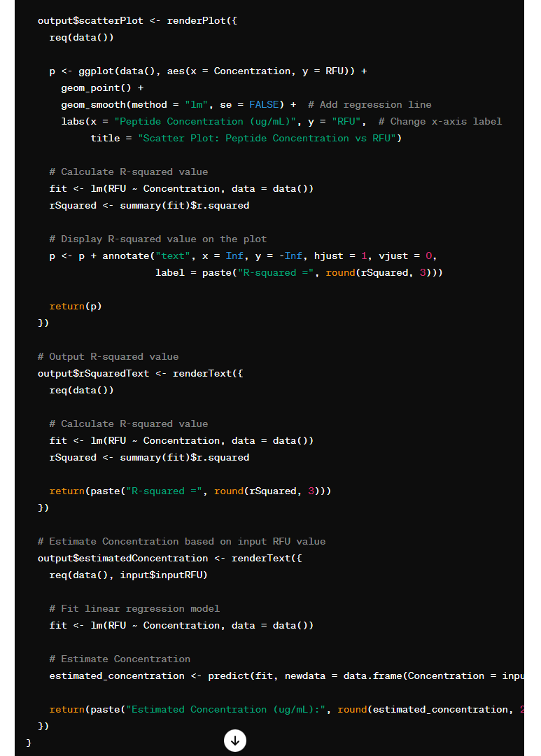
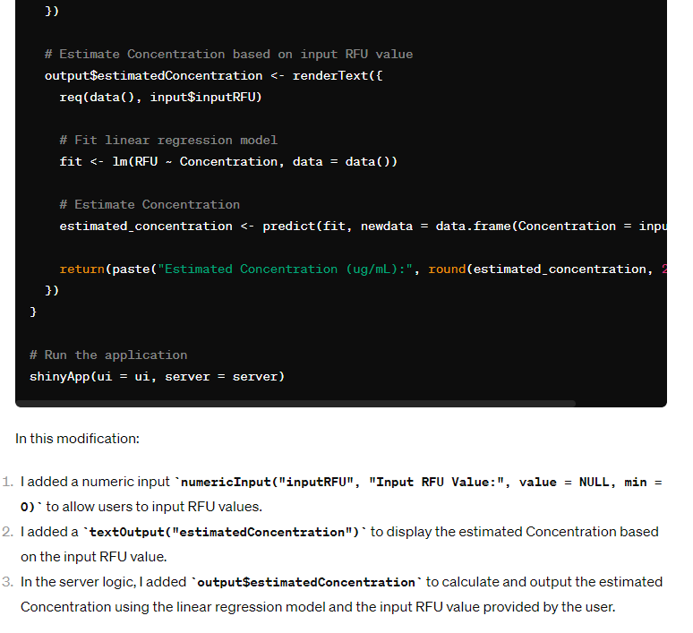

Slide 19
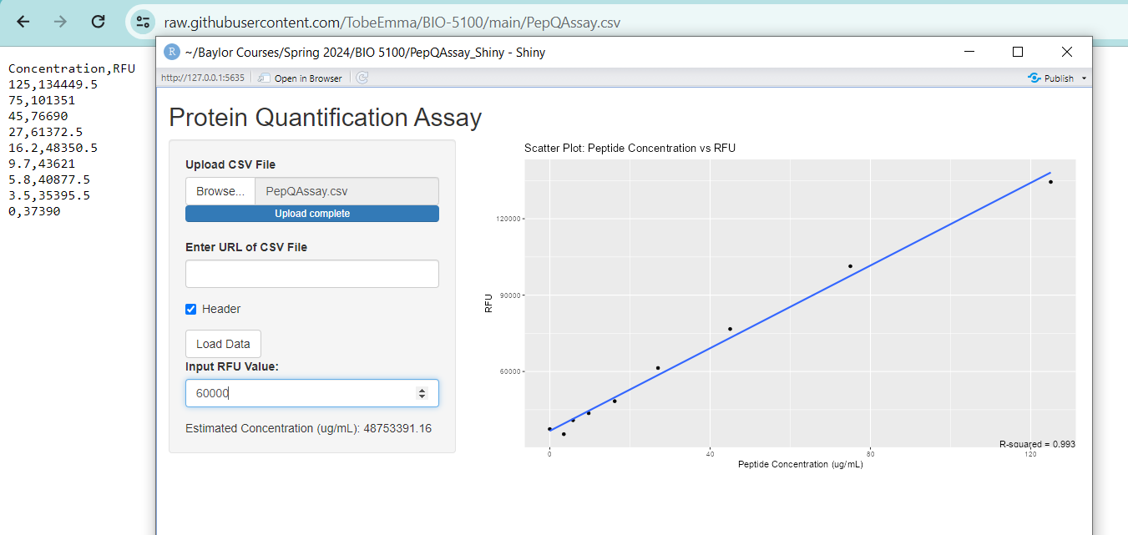
Incorrect Estimate

Slide 20
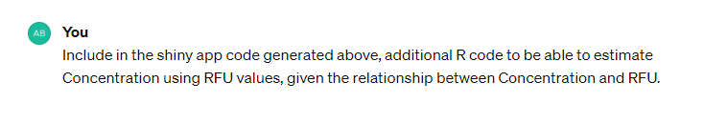
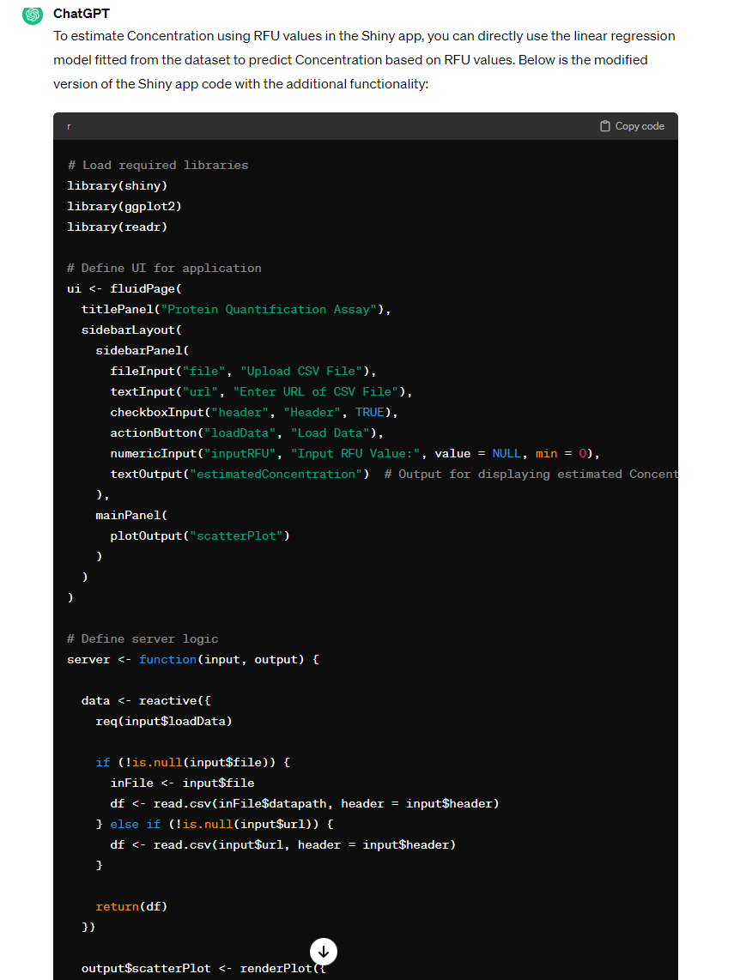
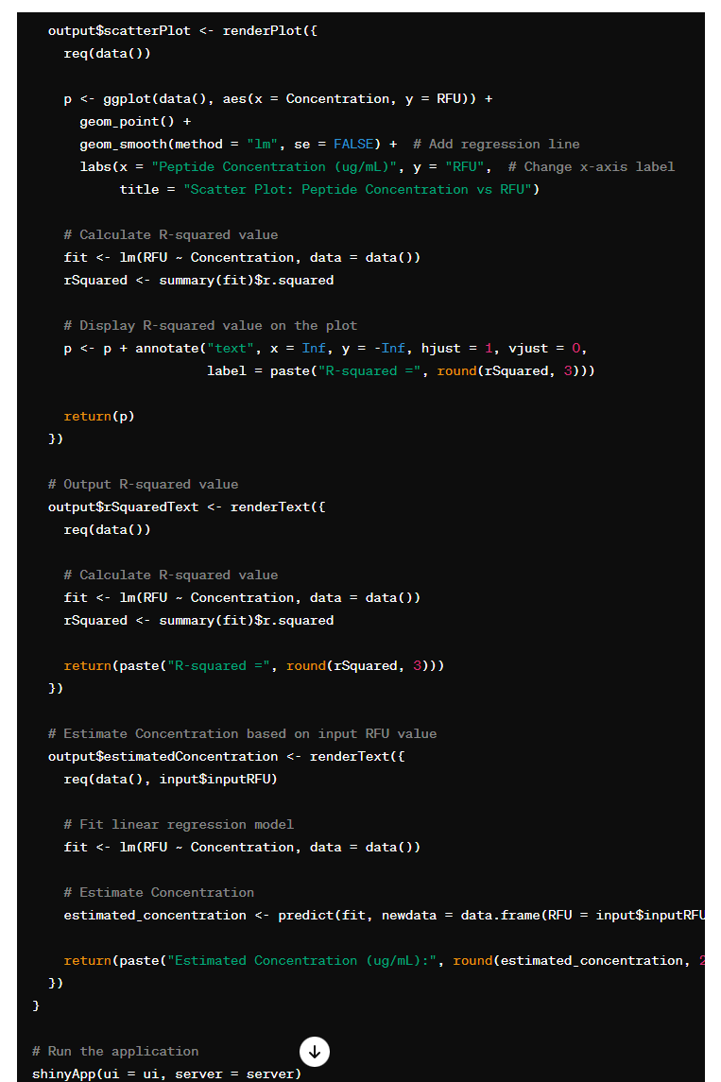
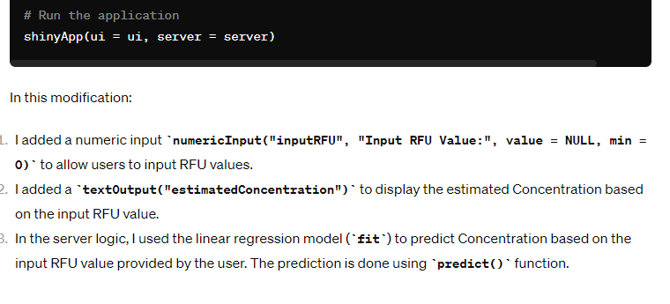

Slide 21
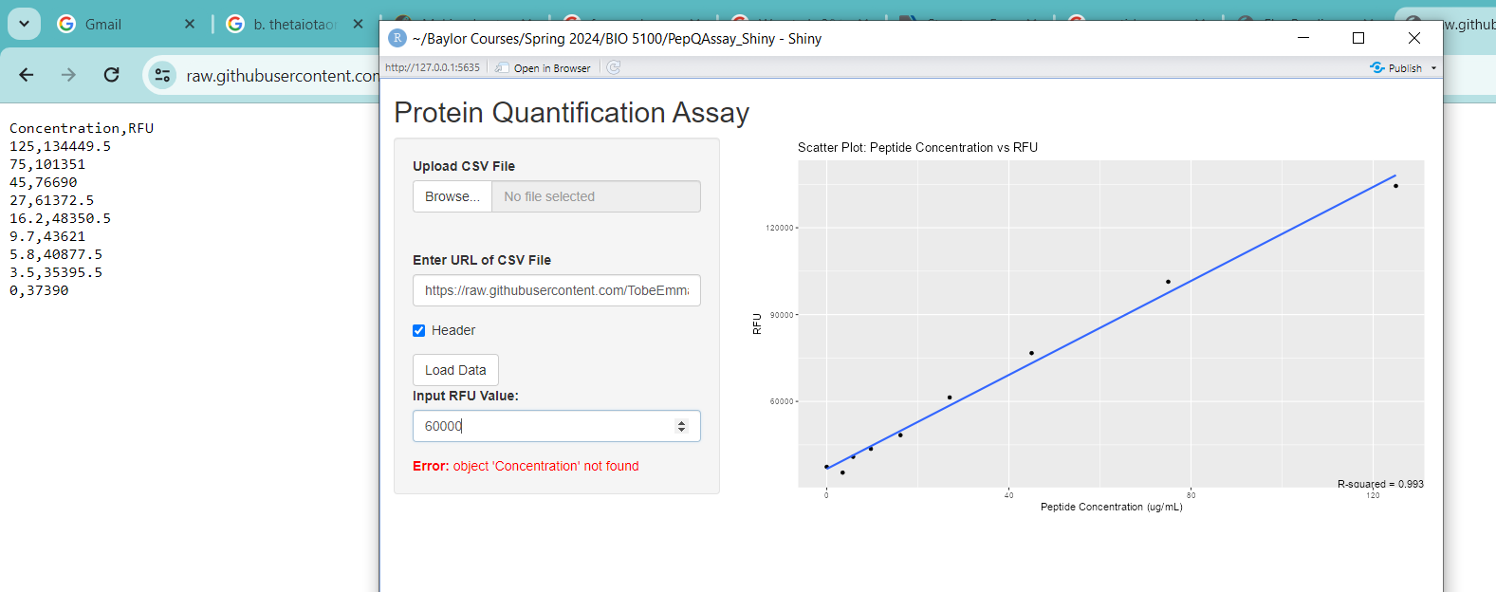
Returns Error

Slide 22
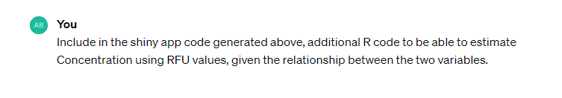
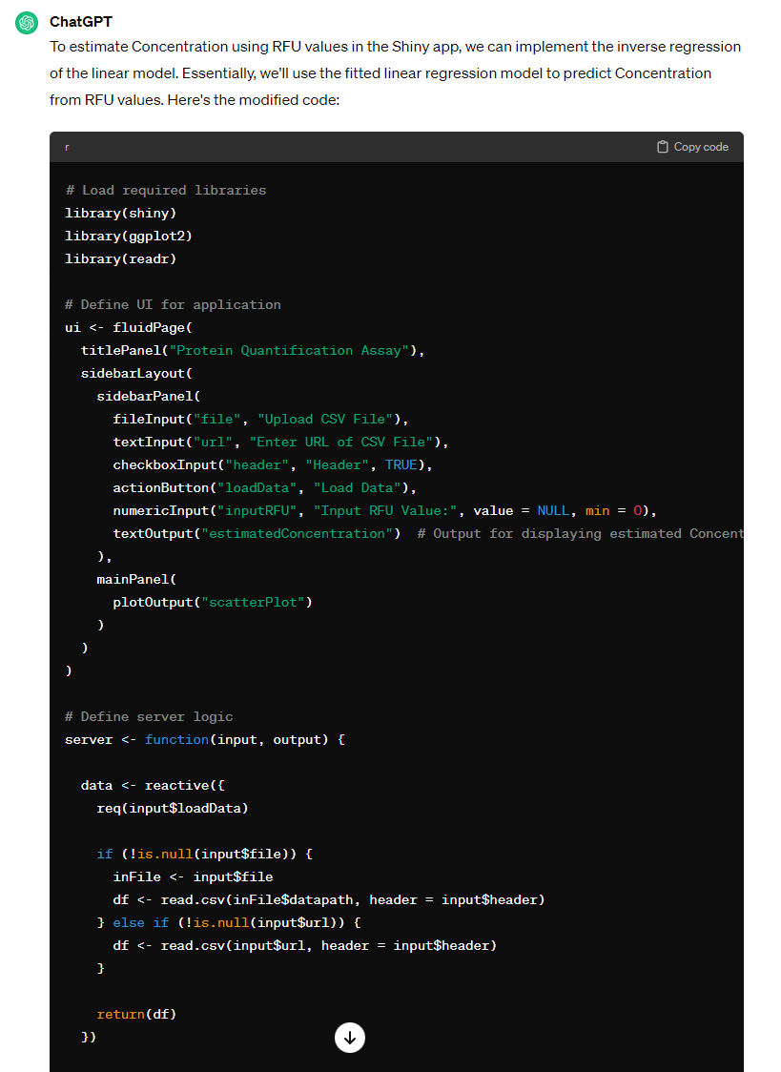
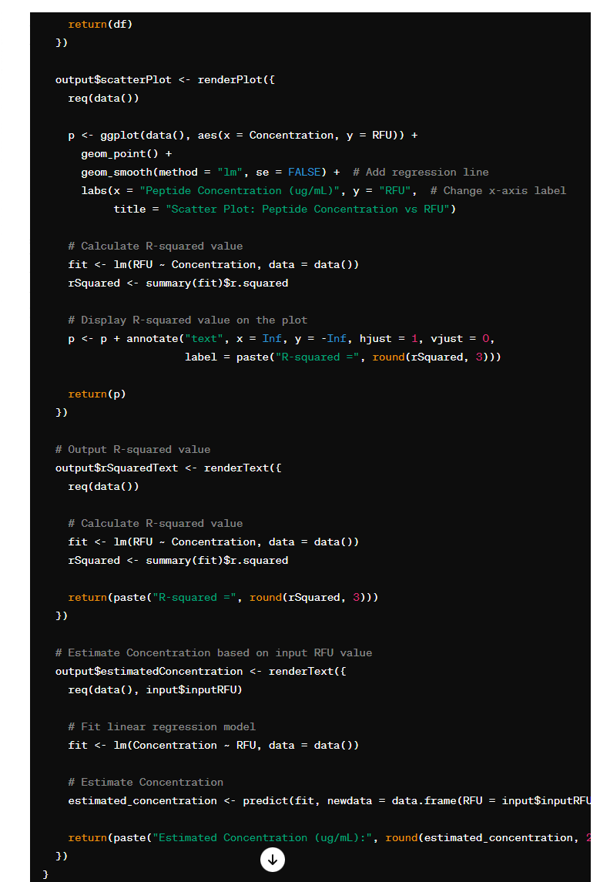
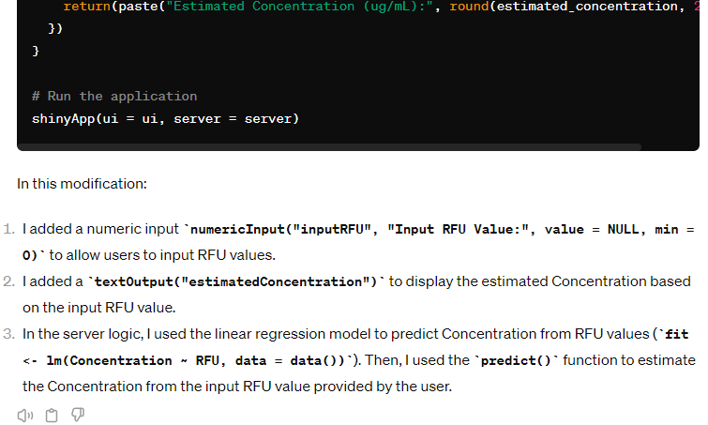

Slide 23
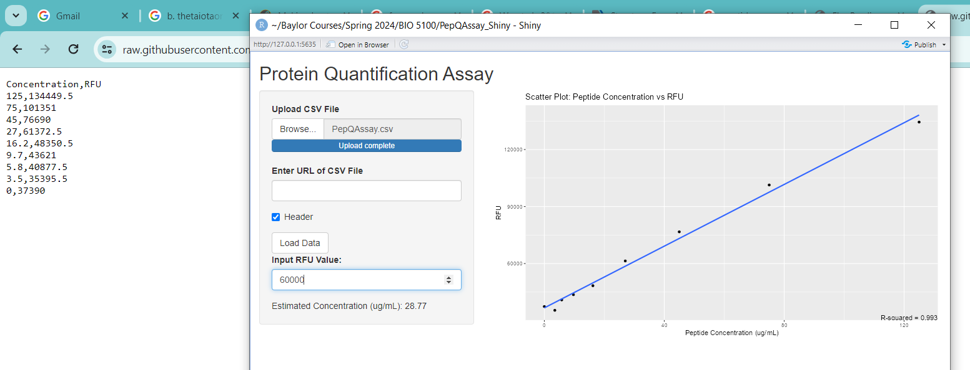
Returns good estimate of the peptide concentration (ug/mL)

Slide 24

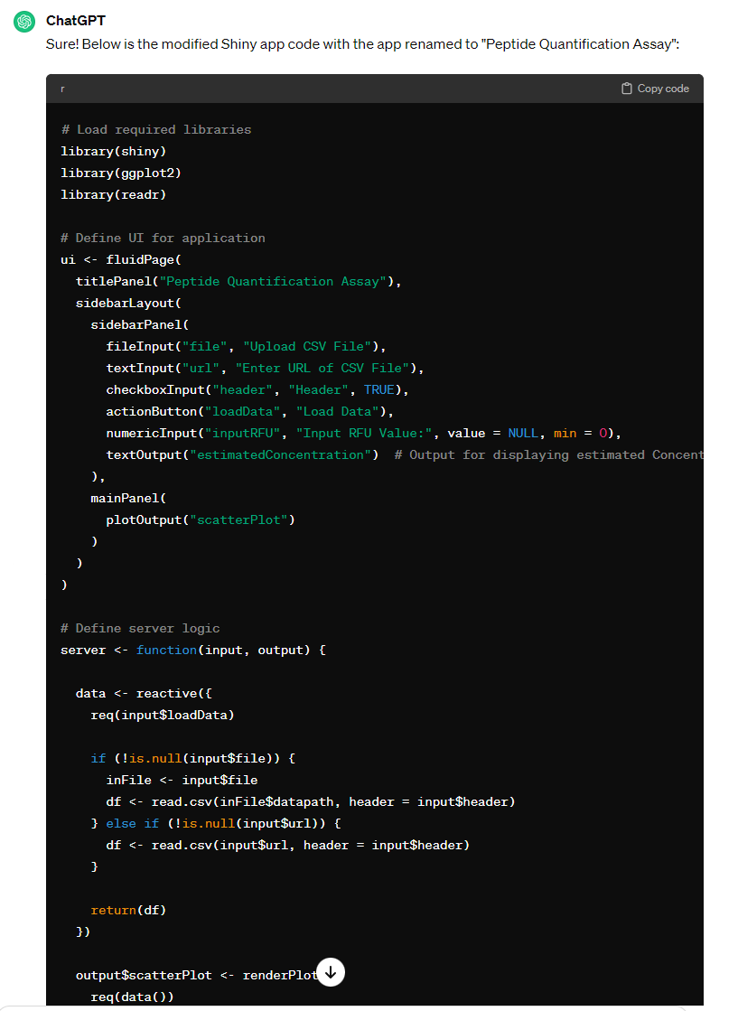
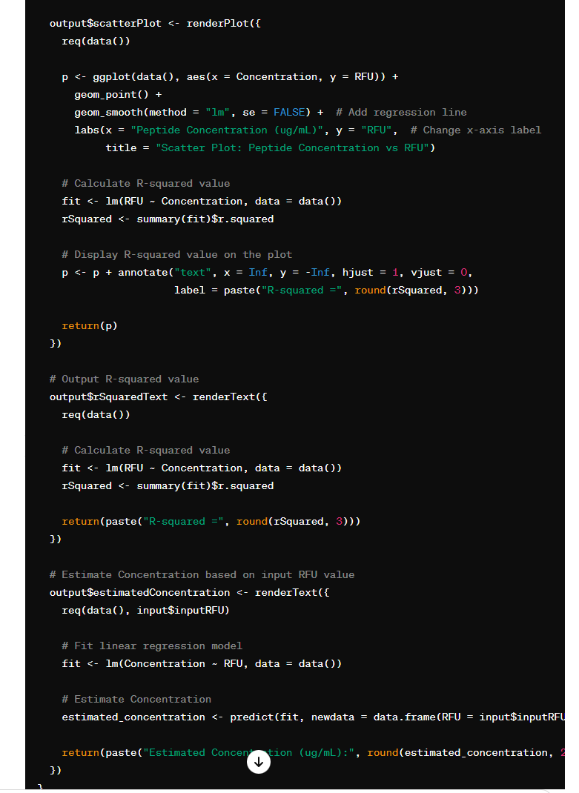
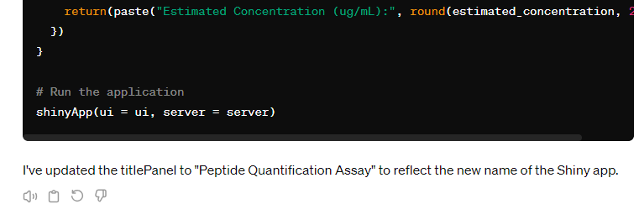
Renaming App

Slide 25
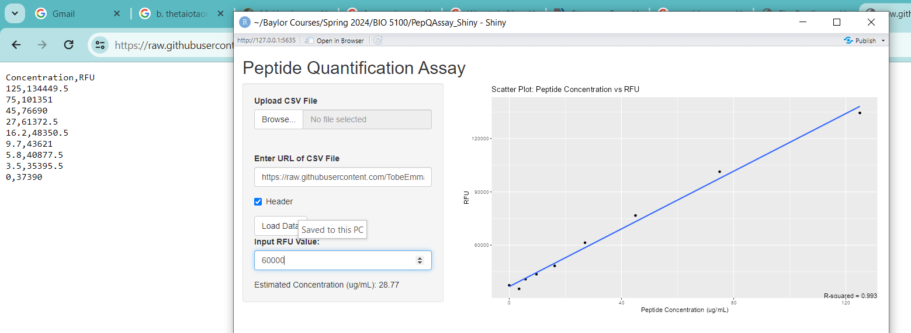
Returns Good Estimate of the peptide Concentration (ug/mL)

Slide 26
Conclusions
I was able to successfully prompt ChatGPT to generate R codes to create a shiny app named “PeptideQuant” that meets the study objectives
I was also able to demonstrate prompts that led ChatGPT to generate functional codes and nonfunctional codes.
Based on this study, ChatGPT can generate functional R codes for shiny apps if given the right prompt.

Slide 27
References
Song, J. G., Baral, K. C., Kim, G. L., Park, J. W., Seo, S. H., Kim, D. H., Jung, D. H., Ifekpolugo, N. L., & Han, H. K. (2023). Quantitative analysis of therapeutic proteins in biological fluids: recent advancement in analytical techniques. Drug delivery, 30(1), 2183816. https://doi.org/10.1080/10717544.2023.2183816
Csibra, E., & Stan, G. B. (2022). Absolute protein quantification using fluorescence measurements with FPCountR. Nature Communications, 13(1). https://doi.org/10.1038/s41467-022-34232-6
Fang, X., Zheng, Y., Duan, Y., Liu, Y., & Zhong, W. (2019). Recent Advances in Design of Fluorescence-Based Assays for High-Throughput Screening. Analytical chemistry, 91(1), 482–504. https://doi.org/10.1021/acs.analchem.8b05303
Hall, M. D., Yasgar, A., Peryea, T., Braisted, J. C., Jadhav, A., Simeonov, A., & Coussens, N. P. (2016). Fluorescence polarization assays in high-throughput screening and drug discovery: a review. Methods and applications in fluorescence, 4(2), 022001. https://doi.org/10.1088/2050-6120/4/2/022001
R Core Team. (2024). R: A Language and Environment for Statistical Computing. From https://www.r-project.org/
Whiting, B. (2022). Bryan Whiting - Building a complex R Shiny Dashboard Using ChatGPT. Bryan Whiting. https://www.bryanwhiting.com/posts/2022-12-15-chatgpt-rshiny/
Dario R. (2024). R Shiny and ChatGPT: Can ChatGPT Help You Make Better R Shiny Apps? (n.d.). https://www.appsilon.com/post/r-shiny-chatgpt

Slide 28

Thank You for Listening

Slide 29
RESEARCH QUESTION
Is there any relationship between peptide concentrations and fluorescent intensity of samples?
If a relationship exists, what is the strength of the relationship between the variables?
Can peptide concentration be estimated using the fluorescent reads?
Can ChatGPT help to develop a tool to visualize the relationship between the two variables?

